Slide 1

DEVELOPING AN AGENT-BASED SIMULATION MODEL OF THE USE OF DIFFERENT COMMUNICATION TECHNOLOGIES IN INTER-ORGANIZATIONAL DISASTER RESPONSE COORDINATION
S. K. AROS AND D. E. GIBBONS, "DEVELOPING AN AGENT-BASED SIMULATION MODEL OF THE USE OF DIFFERENT COMMUNICATION TECHNOLOGIES IN INTER-ORGANIZATIONAL DISASTER RESPONSE COORDINATION," 2018 WINTER SIMULATION CONFERENCE (WSC), GOTHENBURG, SWEDEN, 2018, PP. 68-79, DOI: 10.1109/WSC.2018.8632257.

Slide 2
Abstract
Research Focus: Coordination among organizations in rapid responses to catastrophic disasters
Context: FEMA's National Response Coordination Center
Methodology: Agent-based simulation model
Communication Channels: Web-based Emergency Operations Center, email, phone calls, face-to-face
Simulation Model Overview
Detailing the Web-based Emergency Operations Center, email, phone calls, face-to-face interactions
Emphasis: Replicating support requests and fulfillment processes
Realism: Grounded in real-world FEMA practices and protocols
Specific Aspects Tested
Communication Media: Web-based platform, email, phone, face-to-face
Situational Factors: Addressing challenges unique to disaster response
Research Goals: Testing effectiveness and efficiency in information flow and decision-making
Model Development Process
Sources: FEMA documentation, observations, interviews, exercise data
Challenges: Highlighting difficulties in simulating disaster response activities
Objectives: Addressing specific aspects of communication media and situational factors

Slide 3
Introdiction
Effective disaster response relies on coordinated efforts across multiple organizations.
Timely exchange of accurate information is crucial for resource location and delivery.
Little understanding of how communication options affect response speed.
Research Objective
Testing effects of communication media options on time between disaster request and resource shipment.
Methods: Observation of FEMA exercises, agent-based simulation model development.
Methodology
Observation of catastrophic disaster response exercises by FEMA.
Agent-Based Simulation: Representing communication patterns and resource requirements.
Explored communication media: Web-based system, email, phone calls, face-to-face conversations.

Slide 4
Practical Goal
Identifying optimal communication media combinations for rapid, accurate response.
Focus on large coordination centers handling disaster response requests.
Related Work
Agent-based simulation models improving disaster response operations.
Examples: Nuclear facility emergency plan, emergency vehicle routing, large-scale emergency response.
Key Findings from Prior Work
Saoud et al. (2006): Electronic communication devices reduce rescue delays.
Wang et al. (2012): Exploring response protocols in routing emergency vehicles.
Ruiz-Martin et al. (2016): Analyzing communication in emergency plans for nuclear facilities.
Our Research Contribution
Complementing prior work by addressing complex and imperfect communications.
Synchronous and Asynchronous Media: Investigating various communication challenges.
Practical implications for enhancing disaster response coordination.

Slide 5
Observation during "Ardent Sentry 14" exercise.
Supported by DLA.
Interviews with DLA and FEMA personnel.
Review of FEMA National Incident Support Manual.
.
Task Flow and Hierarchy
Tasks during FEMA-coordinated disaster responses tend to be process-oriented and hierarchical.
Challenges: Imprécise communication, email overload, surges in demands.
Introduction of WebEOC for centralization, but continued use of phone calls, in-person discussions, and email.
initial observations during "Ardent Sentry 14," the Department of Defense portion of FEMA's Capstone 2014.
Supported by the U.S. Defense Logistics Agency (DLA).
Focus on FEMA-coordinated disaster response activities.
Research Setting
"Ardent Sentry 14": Multi-agency catastrophic disaster response exercise.
FEMA National Response Coordination Center (NRCC) as the central hub.
DLA's Joint Logistics Operations Center's perspective.

Slide 6
Complexity
Communication network and request handling surpassed initial expectations.
Complex Communication Network
The initial model focused on top-down, one-to-many information dissemination.
Discoveries
Direct interpersonal communications are crucial for details and problem-solving.
Reinforcement of the necessity of direct observation or participation for realistic simulation models.
Model focus
NRCC floor during the first 72 hours after initiating requests for help.
Formalized and centralized processes.
Figure 1: FEMA's Centralized Order Management and Tracking Process (FEMA 2011).
Model Validation
Initial model observation during a full-scale national disaster response exercise within the NRCC.
Intent: Validate the model and make necessary adjustments.

Slide 7

Observation of FEMA's annual national catastrophic disaster response exercise in spring 2015.
Location: FEMA's National Response Coordination Center (NRCC).
Focus: Shadowing DLA liaison, observing NRCC processes, and engaging with FEMA and supporting organizations.
WebEOC Adoption
Progress in WebEOC adoption compared to the previous year.
Challenges: Difficulty in finding relevant information within WebEOC.
Observations: Representatives leaving desks for questions, potential missed messages during absence.
Communication Challenges
Phone Calls: Delay in attention to other issues.
WebEOC: Frustrating, time-consuming, required multiple exchanges for complex problem-solving.
Non-standard Requests: Iterative communications, extensive problem-solving.

Slide 8
Exercise Observations
FEMA documentation accuracy from a process flow perspective.
Frequency of communications among participants higher than implied by documentation.
Importance of Informal Communications: Spontaneous phone calls, emails, and in-person conversations.
Mission Assignments (MAs): Processing heavily reliant on informal communications.
Conceptual Model Development
Complex conceptual model of the communication network and handling of requests.
Acknowledging the integral role of frequent and informal communications.
Emphasis on the dynamic and often unpredictable nature of communication exchanges.
Implications for Modeling
Shift from a linear process flow to a more dynamic and interconnected model.
Recognition of the importance of informal and spontaneous communication in disaster response.
Adapting simulation models to capture the complexity of real-world communication dynamics.

Slide 9
Conceptual model for FEMA's large-scale disaster response.
Three main areas: State, FEMA, Supporting Organizations ("Brokers").
FEMA Functional Areas: Single entities, gatekeepers in each role.
Brokers: Tier 1 (WebEOC access), Tier 2 (support Tier 1).
Communication Avenues: Diagram representation.
Request Processing: RRF initiation, MA creation, and checks.
Additional Routes and Conclusion
Brokers and NAUL Interaction: RFI, iterative communication.
Additional Routes: Preparedness planning, Verbal Mission Assignments (VMAs).
Conclusion: Flexibility, iterative communication, accuracy, and timeliness.
Q&A: Inviting questions and discussions.

Slide 10
Advanced agreements impact communication needs for request fulfillment.
Pre-Scripted Mission Assignment (PSMA) includes pre-agreed details for specific resources.
PSMA reduces the time needed to fulfill a request.
Request Categories and Urgency Levels
Three request categories: Standard, Non-Standard, and Plan-Initiated.
Urgency Levels: Life-saving (Priority 1), Life-sustaining (Priority 2), High (Priority 3).
Uncommon needs, specific to geography, population, or disaster type, categorized as non-standard.

Slide 11
Communication Media and Functionality
Four communication media modeled: Centralized information system (WebEOC), direct emails, direct phone calls, face-to-face interactions.
Functionality Differences:
System and Email: Hand off requests, placed in queue.
Phone Calls and Face-to-Face: Synchronous communication with added delays.
Richer Communication Forms: Higher probability of successfully completing and correcting request details.
MAs routed in the computer system; RFIs usually via email, with escalation options for richer communication.

Slide 12
Simulation Methodology
Agent-based simulation methodology chosen for decision-making agents in the communication network.
NetLogo 5.1.0 used for model development due to flexibility, ease of use, dashboard feature, and BehaviorSpace utility.
Roles in Figure 2 represented as agents; Master request agent for each state need; Request item agent for each communication vehicle.
Model Components
Master requests associated with RRF, MA, 0 or 1 VMAs, and possibly multiple RFIs.
Model dashboard with animation to adjust parameters and observe communication and request fulfillment.
Challenges addressed: Model parameterization and verification/validation

Slide 13
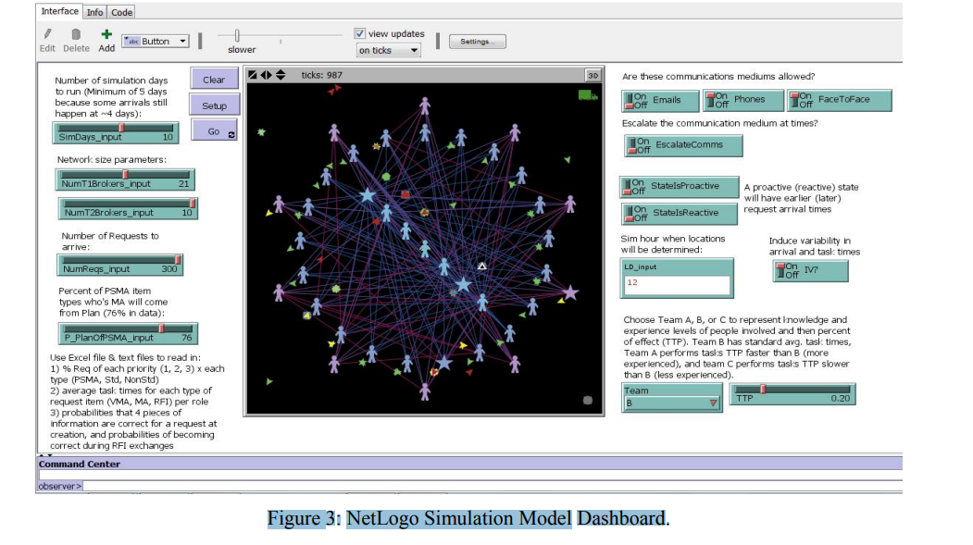
Model Dashboard Snapshot
FEMA roles, Tier 1 and Tier 2 brokers represented with people icons and stars/Xs for phone calls and face-to-face interactions.
Triangles depict request item agents in queues.
Figure 3: NetLogo Simulation Model Dashboard.
Model Parameters Manipulation
Dashboard allows manipulation of model parameters:
Number of each broker type.
Number of requests and percentage initiated from the plan.
Communication medium allowance and escalation options.
State's proactive or reactive approach.
Timing of response staging locations decision.
Variation in personnel skill level for NRCC.

Slide 14
Parameter Determination:
Values for percent of overall PSMA and plan-initiated requests.
Estimated percent of non-PSMA non-standard vs. standard requests (assumed 3% non-standard).
Proportion of requests for each priority level.
Distribution of request arrival over the first 96+ hours post-disaster.
Tier 1 Brokers Range Determination:
Number of support agencies assigned MAs informed the range (12 to 30).
Tier 2 Brokers and Requests:
Range estimation for Tier 2 brokers (5 to 10) and varying requests assignment due to lack of actual data.
Model Parameterization from Exercise Data
Most MAs from the exercise had a single resource request; some had multiple bundled as Mission Assignment Task Orders (MATO).
Analysis Approach:
Counted each MA as one request.
Counted each MATO/MA as one request.
Result:
Range of possible requests in the model: 100 to 300.
Additional Exercise Data Utilization:
PSMA usage, initiation from the plan, MA creation time relative to simulated disaster onset, and urgency.
he model and make necessary adjustments.

Slide 15
Focus of V&V:
Emphasis on the validity of the conceptual simulation model and model parameters.
Lacked empirical data, so validation efforts focused on ensuring realism based on subject matter experts and exercise data.
Incremental Model Development:
Verification maintained through incremental development.
Functionality of each code section verified before moving to the next.
Code heavily commented for clarity.
Animation and error-checking routines used to enhance verification.
Validation Approach:
Goal: Relative performance under different scenarios rather than precise prediction.
Model considered 'good enough' for the intended purpose.
Model Verification and Validation
Verification and Validation (V&V) Definitions:
Verification: Ensuring the simulation program performs as intended.
Validation: Determining if the conceptual simulation model accurately represents the system under study.
Challenges in ABMS V&V:
Difficult in the absence of continuous or regular system operation.
No comprehensive tool set for ABMS V&V due to diverse application domains.
Guiding Framework for V&V:
Used Kleijnen's (1995) framework for "simulation models in operations research" to guide V&V efforts.

Slide 16
Initial Experiment and Results
Objective:
Assess the effectiveness of communication technologies as additions to the Centralized Information System (CIS) for processing disaster response requests.
Baseline Condition:
CIS-only usage assumed for all players (suppliers, state, FEMA, brokers).
Experiment Design:
Full factorial experiment testing all combinations of media options and communication escalation.
Varied network size, overall requests, and percentage of requests with Pre-Scripted Mission Assignments (PSMAs).
Primary Performance Metric:
Average Need Flow Time: Duration from state presentation of a need to FEMA through an RRF to shipment initiation.
Additional Metrics:
Request Flow Time: Average duration from request arrival to shipment initiation.
Request Duration: Overall average Request Flow Time across all requests.
Global Flow Time: A six-item scale (alpha = 0.91) derived from factor analysis, used as an overall performance metric.
Data Collection:
20 instances of every parameter combination.
Analysis:
Correlation identified highly correlated metrics.
Factor analysis produced a six-item scale (Global Flow Time).

Slide 17
Effect of Reliance on CIS
Key Finding:
Exclusive reliance on the Centralized Information System (CIS) for information exchange prolongs request fulfillment compared to scenarios with direct interpersonal communication options.
Mean Flowtimes (in hours):
CIS-only vs. Any Direct Communication Media
PSMA Requests: 273.87 vs. 199.52
Standard Requests: 467.59 vs. 295.95
Non-standard Requests: 1542.32 vs. 1268.08
Consistent Impact Across Scenarios:
The negative effect of CIS-only reliance holds across different network sizes, configurations, and percentages of requests with Pre-Scripted Mission Assignments (PSMAs).
Broker Network Indicator:
Denotes network configuration with respect to the number of Tier 1 and Tier 2 Brokers.
Networks 1 to 3: 12, 21, and 30 Tier 1 brokers, respectively, with 5 Tier 2 brokers.
Networks 4 through 6: Similar but with 10 Tier 2 brokers.

Slide 18
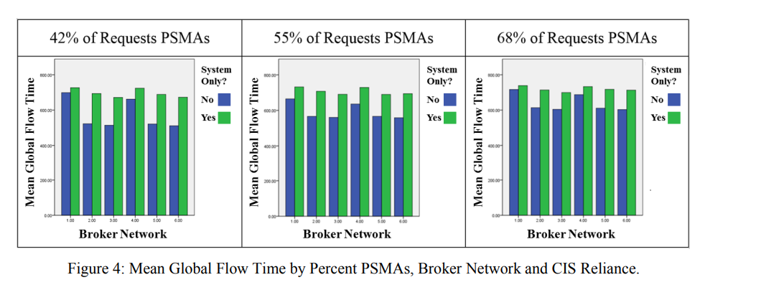
Graph (Figure 4):
Illustrates the impact of CIS-only reliance on mean flowtimes across different network configurations.

Slide 19
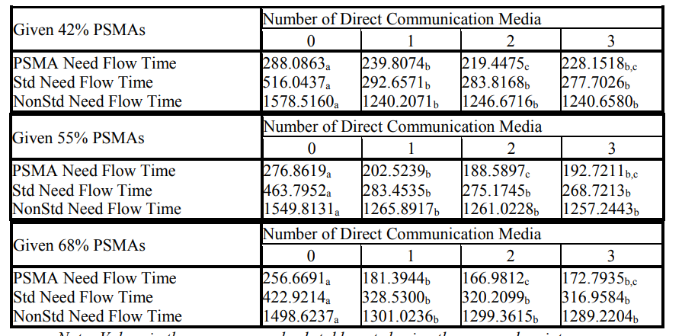
Table 1: Mean Need Flow Times (in hours) for Different Communication Options:

Slide 20
PSMA Requests:
No Media (a): Higher flow times
One Medium (b): Higher than Two Mediums (c)
Two Mediums (c): Lowest flow times
Three Mediums (c): Similar to Two Mediums (c)
Standard Requests:
No Media (a): Higher flow times
One Medium (a): Similar to Two and Three Mediums (b, c)
Two Mediums (b): Similar to One and Three Mediums (a, c)
Three Mediums (c): Similar to One and Two Mediums (a, b)
Non-Standard Requests:
No Media (a): Higher flow times
One Medium (a): Similar to Two and Three Mediums (b, c)
Two Mediums (b): Similar to One and Three Mediums (a, c)
Three Mediums (c): Similar to One and Two Mediums (a, b)
Pattern Across Different PSMA Percentages:
Robust pattern of results across increases in the proportion of requests with Pre-Scripted Mission Assignments (PSMAs).
]

Slide 21
Direct Effects of Specific Communication Media
Key Findings:
Email consistently reduced flow times across all levels of PSMA requests.
Phones and face-to-face (F2F) options were helpful for non-PSMA requests, especially non-standard requests.
Direct Effects of Specific Communication Media:
Email:
Reduced flow times for all four outcome measures.
Example: Average time to complete a standard request decreased by 79 minutes.
Phones and F2F:
Helpful for all except PSMA requests.
Particularly valuable for non-standard requests.
Effects of Communication Options in Combination
Key Insights:
Singular use of email or combined use of email and face-to-face conversations produced the fastest mean flow times for PSMA and standard requests.
Face-to-face conversations slightly lowered flow times for non-standard requests.
Table 2: Effects of Combinations of Communication Options on Need Flow Times:
PSMA and Standard Requests:
Singular use of email or joint use of email and F2F conversations: Fastest mean flow times.
Non-Standard Requests:
F2F conversations slightly lowered flow times.

Slide 22


